Slide 1
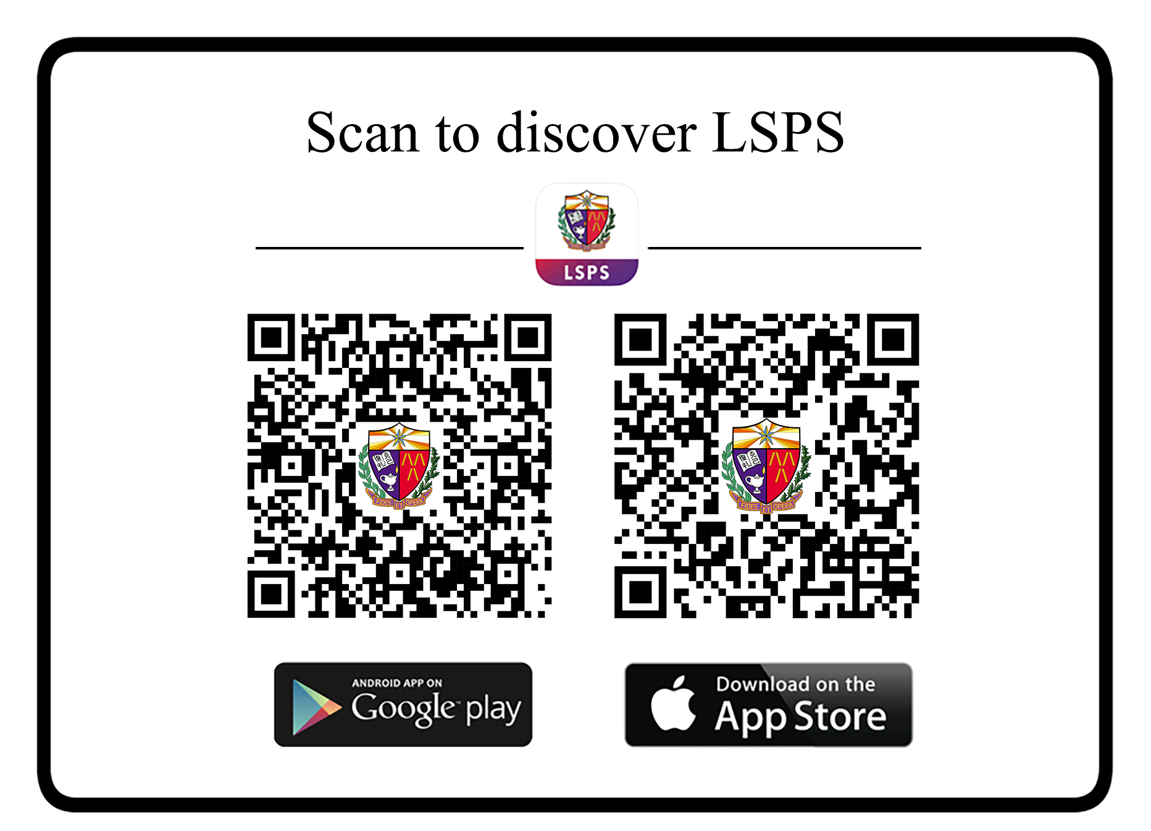

Slide 2
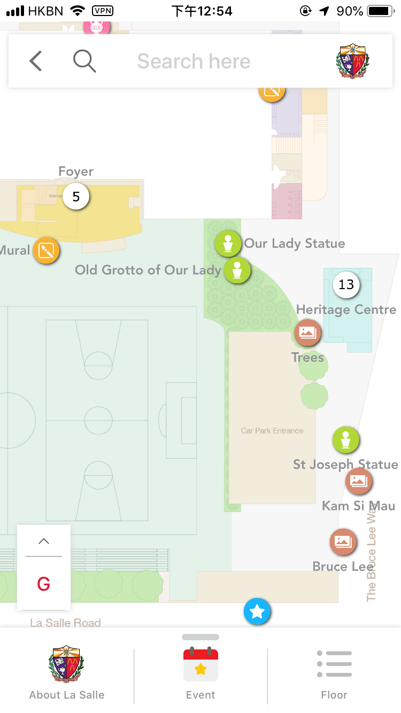
Step 1
Select Event

Slide 3
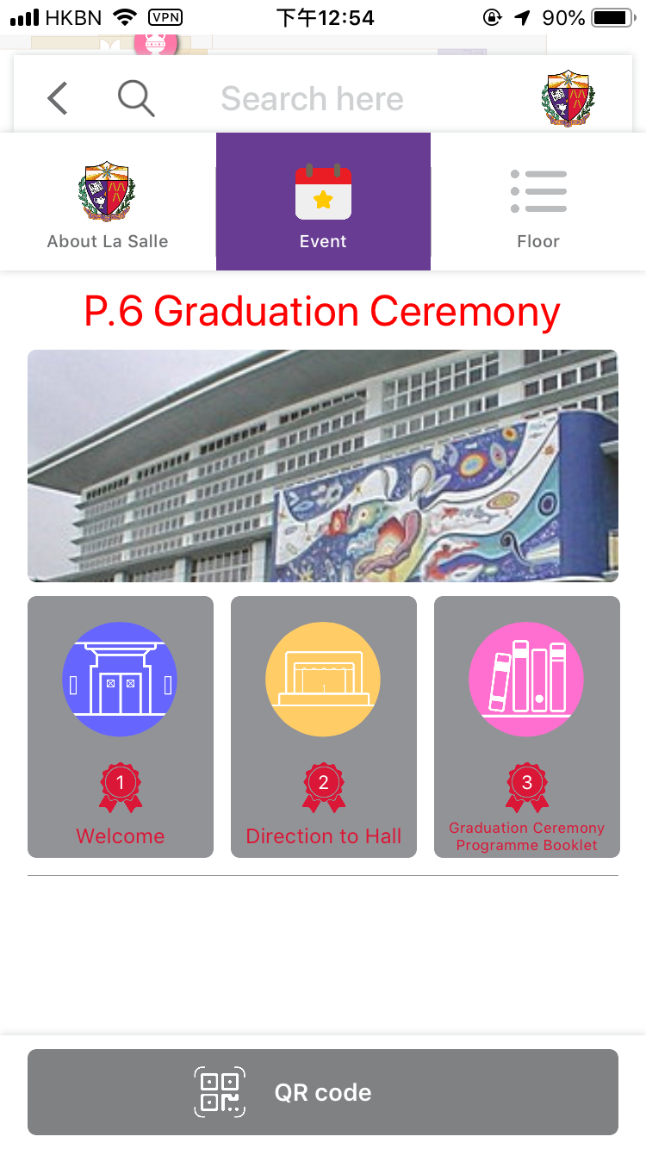
Step 2
Programme Booklet

Slide 4

Step 3
Download
Booklet

